Slide 1
AIDS treatments study
Joanna Chung|Lucy Pham|Kriza Diane Sy|Argho Chakma
Health and Medicine
Classification

Slide 2
Group members
Joanna Chung - 300382756
Lucy Pham – 300391851
Kriza Diane Sy - 300380667
Argho Chakma - 300367039

Slide 3
Table of contents
01
02
Introduction
Logistic Regression
Background & Dataset Summary
03
04
Random Forest Classifier
Conclusion

Slide 4
Introduction

Slide 5
Overview of the Dataset
From a double-blind, placebo-controlled trial comparing nucleoside monotheraphy and combination therapy on adults infected with human immunodeficiency virus type 1 (HIV-1)
Zidovudine (ZDV) - the first effective antiretroviral drug for HIV, is approved by the FDA
Didanosine (ddl) - introduced as a new option for patients who couldn't tolerate zidovudine (AZT) or whose HIV continued to worsen despite taking AZT alone
Zalcitabine was the third antiretroviral to be approved by the Food and Drug Administration for the treatment of HIV/AIDS
Notes:
<What are we trying to understand/get out of this project?>
Effect of certain treatment to cell counts (CD4 and CD8) of AIDS patients
CD4 refers to a type of white blood cell that plays a crucial role in the immune system
CD8 are cells involved in controlling HIV replication and limiting the spread of the virus within the body

Slide 6
Summary of Dataset
2139 entries, 0 to 2138
Data columns (total 24 columns):
# Column Non-Null Count Dtype
--- ------ -------------- -----
0 time 2139 non-null int64
1 trt 2139 non-null int64
2 age 2139 non-null int64
3 wtkg 2139 non-null float64
4 hemo 2139 non-null bool
5 homo 2139 non-null bool
6 drugs 2139 non-null bool
7 karnof 2139 non-null int64
8 oprior 2139 non-null bool
9 z30 2139 non-null bool
10 zprior 2139 non-null bool
11 preanti 2139 non-null int64
12 race 2139 non-null bool
13 gender 2139 non-null bool
14 str2 2139 non-null int64
15 strat 2139 non-null int64
16 symptom 2139 non-null bool
17 treat 2139 non-null int64
18 offtrt 2139 non-null bool
19 cd40 2139 non-null int64
20 cd420 2139 non-null int64
21 cd80 2139 non-null int64
22 cd820 2139 non-null int64
23 cid 2139 non-null int64
dtypes: bool(10), float64(1), int64(13)
memory usage: 255.0 KB
Most of the datatypes of the features are Boolean or categorial variable
Contains data on demographics, medical and treatment history
Our predictive variable would be cid (binary datatype) censoring indicator (1 = failure, 0 = censoring)
Notes:
Most of the datatypes of the features are
Boolean or categorial variable
Our predictive variable would be cid (binary datatype) censoring indicator (1 = failure, 0 = censoring) Failure (1): This indicates that a patient's HIV treatment regimen is no longer effective in controlling the virus. This could be evidenced by a sustained increase in the viral load Censored (0): This indicates that a patient discontinued treatment for reasons other than treatment failure. There are several reasons why a patient might be censored:
Loss to follow-up: The patient stops attending clinic visits or providing blood samples, making it impossible to determine treatment success.
Death: The patient dies from causes unrelated to HIV/AIDS.
Treatment switch: The patient switches to a different HIV treatment regimen for reasons other than failure, such as side effects or drug interactions.
End of study: The patient completes the study period without experiencing treatment failure.
Chi^2 statistical model specifically for categorical variables
So we will perform classification
Second point:
treatment indicator (0 = ZDV only; 1 = ZDV + ddI, 2 = ZDV + Zal, 3 = ddI only)

Slide 7
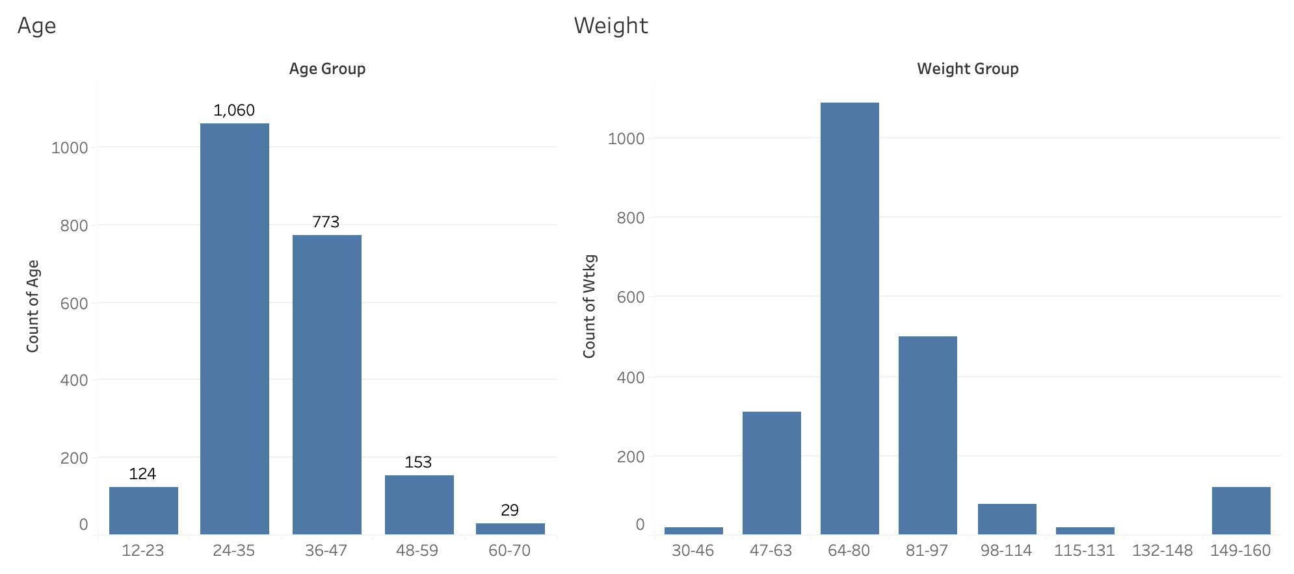
Demographics Overview

Slide 8
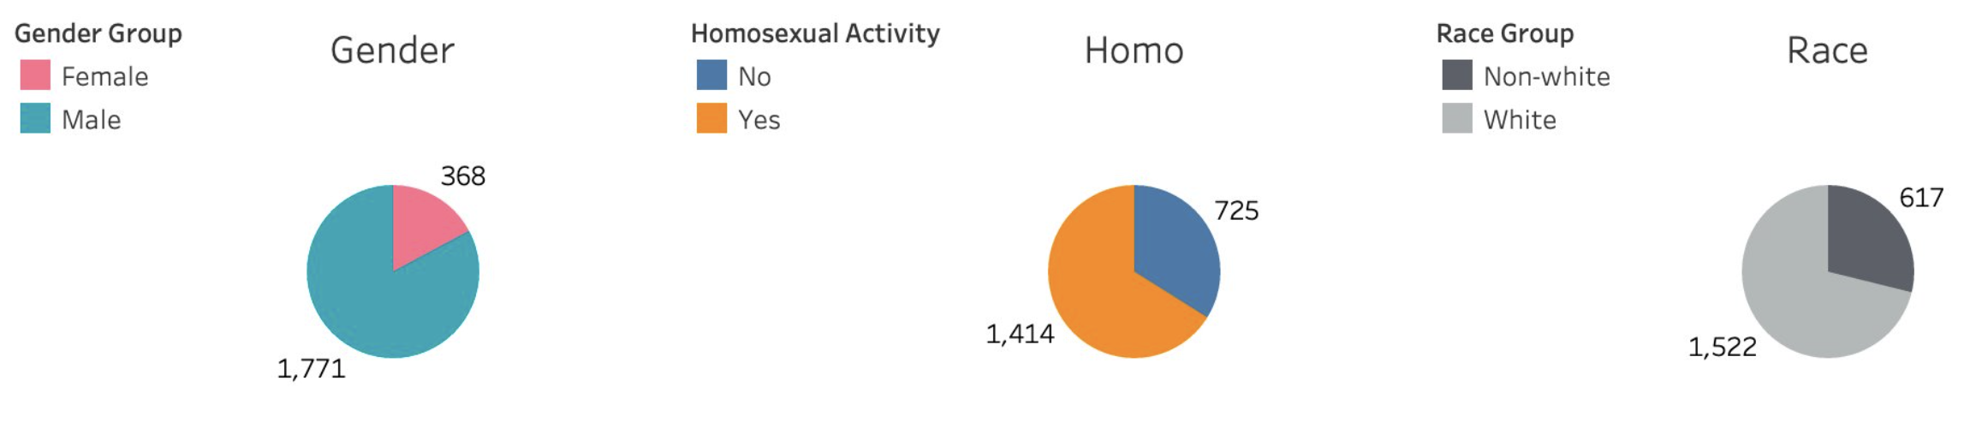
Demographics Overview

Slide 9
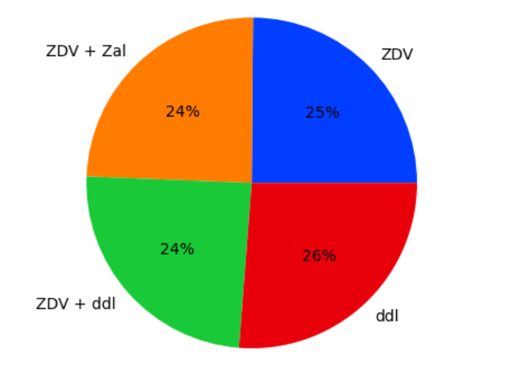
Treatment
Trt: treatment indicator
0 = ZDV only
1 = ZDV + ddI
2 = ZDV + Zal
3 = ddI only

Slide 10
Data Preprocessing
Encoded categorical variables
Dropped duplicated columns
Feature Scaling & Feature Selection
'treat','str2'
# encode categorical variables, drop unrelated or duplicated features
df1 = pd.get_dummies(df, columns=['trt', 'strat’])
# dropped duplicated columns
df1 = df1.drop(['treat','str2'], axis=1)
Notes:
We will perform feature scaling for logistic regession. Although logistic regression is theoretically not sensitive to feature scaling,but it can help improve convergence speed and performance in practice.
Treat and str2
treat, Binary, treatment indicator (0=ZDV only, 1=others)
str2, Binary, antiretroviral history (0=naive, 1=experienced)
Created dummy variables
trt column into 4 columns labeled as trt_0, trt_1, trt_2, trt_3

Slide 11
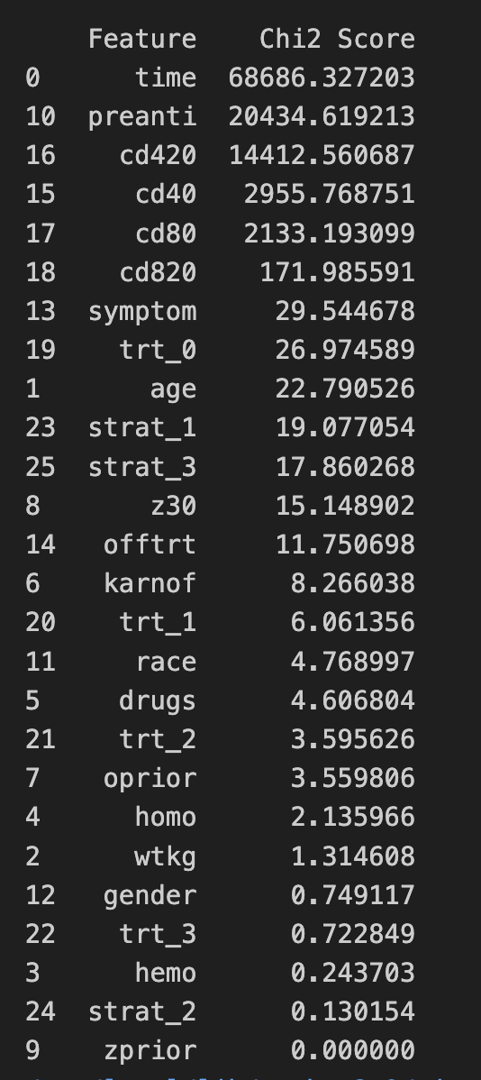
Feature Selection - Chi-squared test
Strong Association: time
Moderate Association: preanti, cd420, cd40, cd80
Moderate to Weak Association:
cd820, symptom, trt_0
Weak Association:
age, strat_1, strat_3, z30
Very Weak Association:
offtrt, karnof, trt_1, race, drugs, trt_2, oprior
Negligible Association: (Drop)
homo, wtkg, gender, trt_3, hemo, strat_2, zprior
Encoded categorical variables
Dropped duplicated columns
'treat','str2'
Notes:
Most of our input variable are binary and categorical variable, and output variable is binary variable so we chose to use chi-sqared stat test to perform the feature selection.
Trt_0 seems to be affect the result more, but we stil couldn’t conclude, since it only is moderate asoociation, but we can conclude trt_3 did not affect much on the result.
We will perform feature scaling for logistic regession. Although logistic regression is theoretically not sensitive to feature scaling,but it can help improve convergence speed and performance in practice.

Slide 12
Logistic Regression model

Slide 13
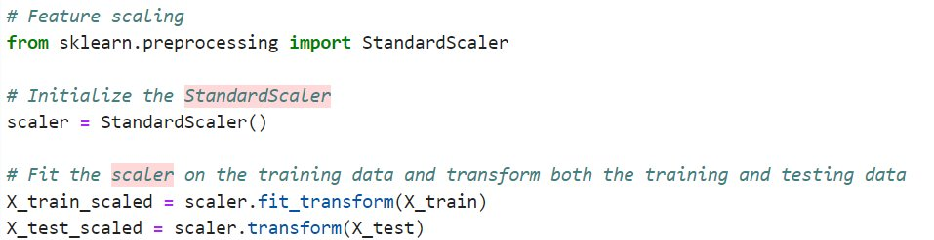
Feature Scaling
Notes:
The core of logistic regression is a linear regression. However, Linear regression is heavily affected by the scale of the data. Therefore, we must scale the data first before running the model.

Slide 14
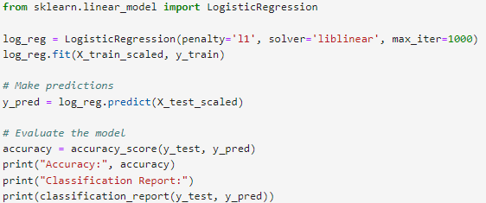
L1 (Lasso) regularization Logistic Regression
Notes:
Explain y need to use lasso

Slide 15
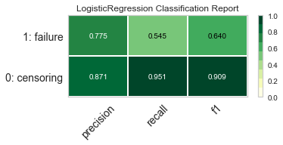
Logistic Regression Report
Predict well of class 0
Less accurate in identifying class 1
High Accuracy Score
Accuracy score: 0.86

Slide 16
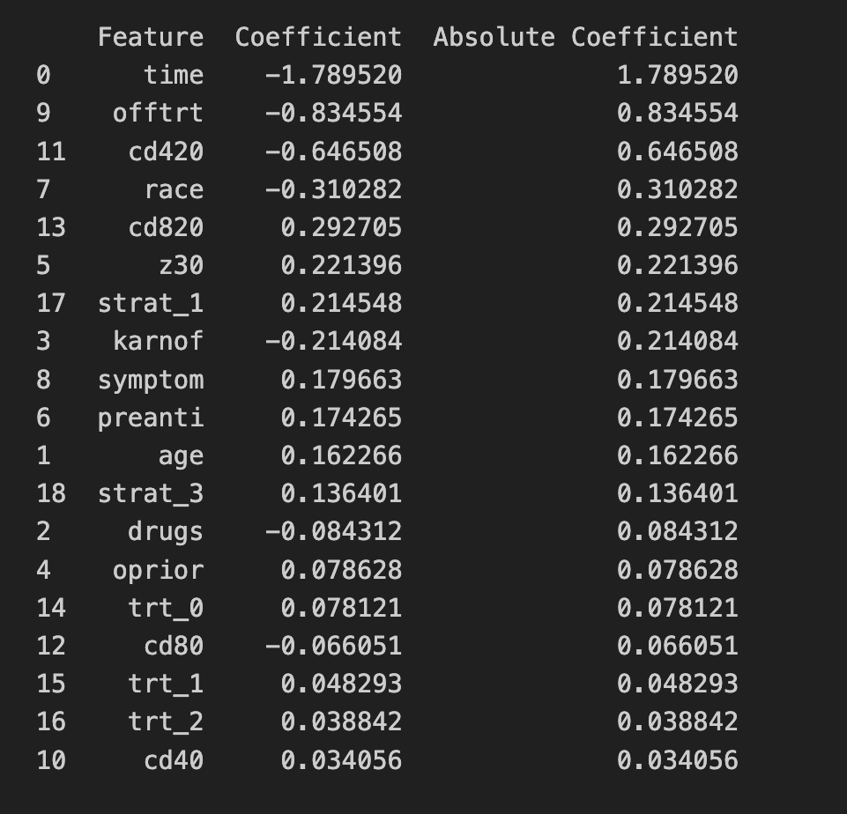
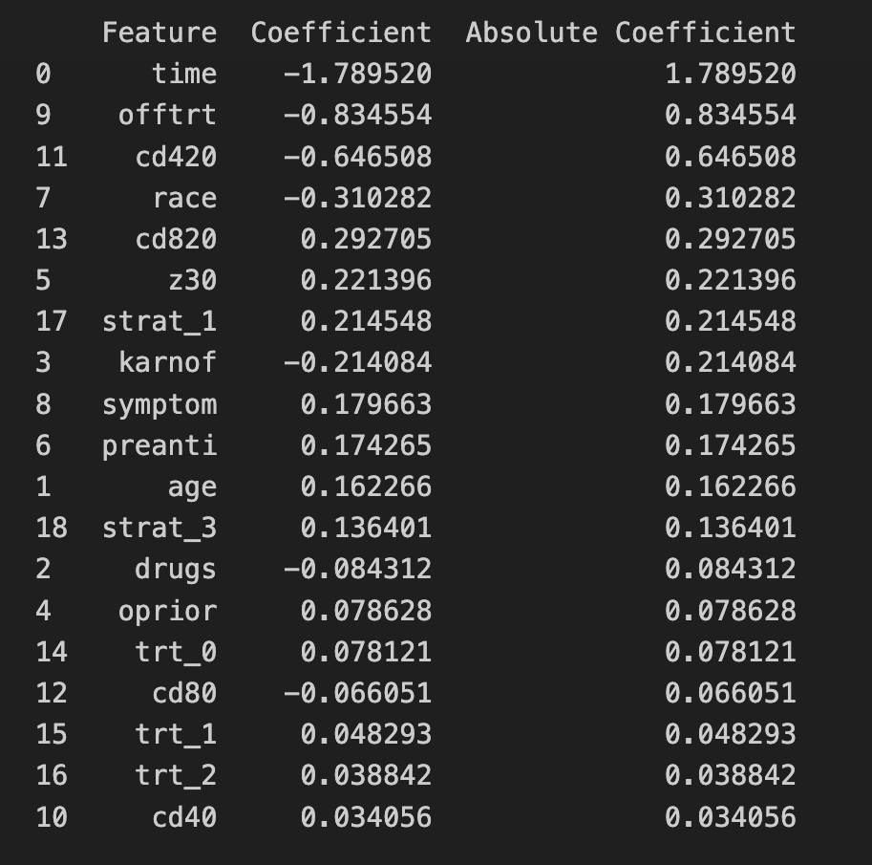
The coefficient of the treatments
Top 5 features can contribute to the high accuracy.
Cannot conclude which is the best treatment.
Notes:
The 5 highest features contribute to the logistic model. Our purpose just to find out which treatment was useful, but their coefficient are quite low so we cannot conclude which treatment was the best. The highest coefficient variables can contribute to the high accuracy

Slide 17
Random Forest model
Notes:
Since we cannot conclude which treatment is better in logistic regression, so we decide to further perform a stronger model which is random forest.
It is an ensemble learning method that can build multiple decision trees during training to improve the accuracy score.

Slide 18
Random Forest Classifier – hyperparameters tuning
Number of trees in the forest
param_grid = {
'n_estimators': [50, 100, 150],
'max_depth': [None, 10, 20],
'min_samples_split': [2, 5, 10],
'min_samples_leaf': [1, 2, 4]
}
Maximum depth of the trees
Minimum number of samples required to split an internal node
Minimum number of samples required to be at a leaf node
Best Parameters:
{'max_depth': 10, 'min_samples_leaf': 1, 'min_samples_split': 2, 'n_estimators': 150}
Notes:
There are lots of hyperparameters of the random forest classifier to be tuned
And we have used the GridSearchCV to help us find the best parameters

Slide 19
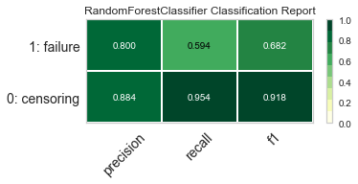
Classification Report
Predict well of class 0
Less accurate in identifying class 1
High Accuracy Score
Accuracy Score: 0.87
Notes:
The accuracy of the model is 0.87, which is slightly better than logistic regression
And we have printed the classification report as well, and it is also same as the logistics regression which
It performs well in predicting class 0 with high precision, recall and f1. However, it is less accurate in identifying class 1 (failure),
Next we will c is there any result for different treatment by calculation the feature importance score.

Slide 20
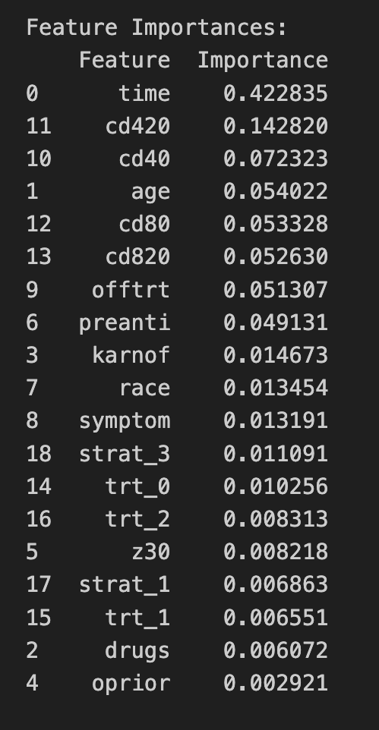
Feature Importance
Time: time to failure or censoring
cd420: CD4 (white blood cell) count after the treatment
The importances of the treatment options
(trt_0, trt_1, trt_2):
- relatively low
- close to each other
can't conclusively determine which treatment is better
Jupiter is the biggest planet
Notes:
So different from logstic regression which use coefficient score, they have a feature importance score.
Still, What made it predict pretty well is the time to failure or censoring and the white blood cell number after the treatment (cd420)
The importances of the treatment options (trt_0, trt_1, trt_2,) are still relatively low and close to each other. None of them stands out significantly as the most important feature.
We have also train naïve bayes model to c result, but we got similar result as the rf and logstic resgression, so we didn’t included it.
So instead of trying different models,
we are thinking would the treatment just effective for specific age group
Therefore, next part we move on to the subgroup analysis for the age of the patent

Slide 21
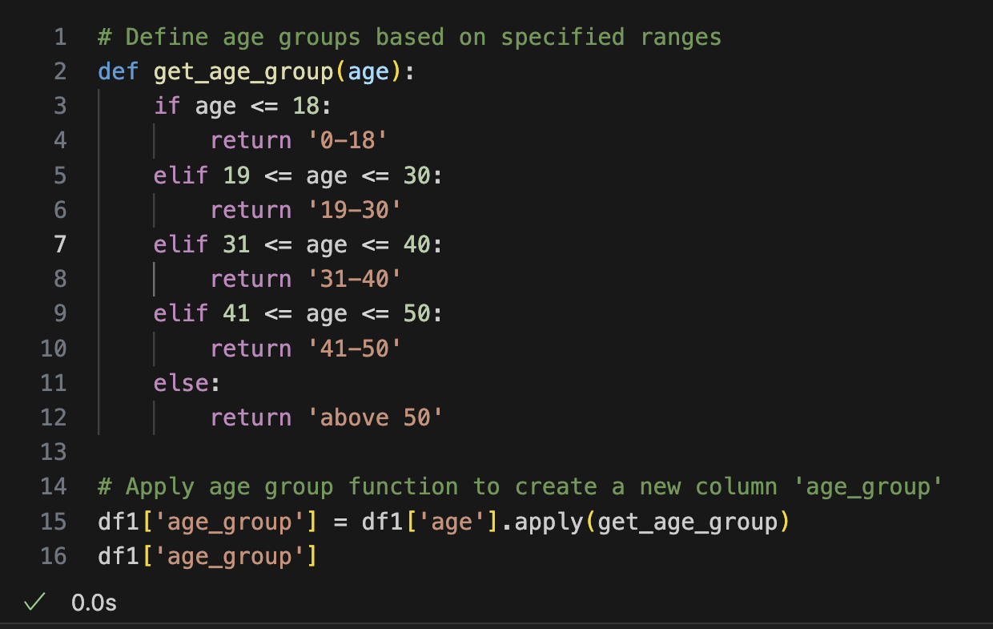
Subgroup Analysis (Age Group)
Outcome (5 age groups):
0 41-50
1 above 50
2 41-50
3 41-50
4 41-50
...
2134 19-30
2135 0-18
2136 above 50
2137 0-18
41-50
Name: age_group,
Length: 2139, dtype: object
Notes:
First, we separate the patients into 5 age groups

Slide 22
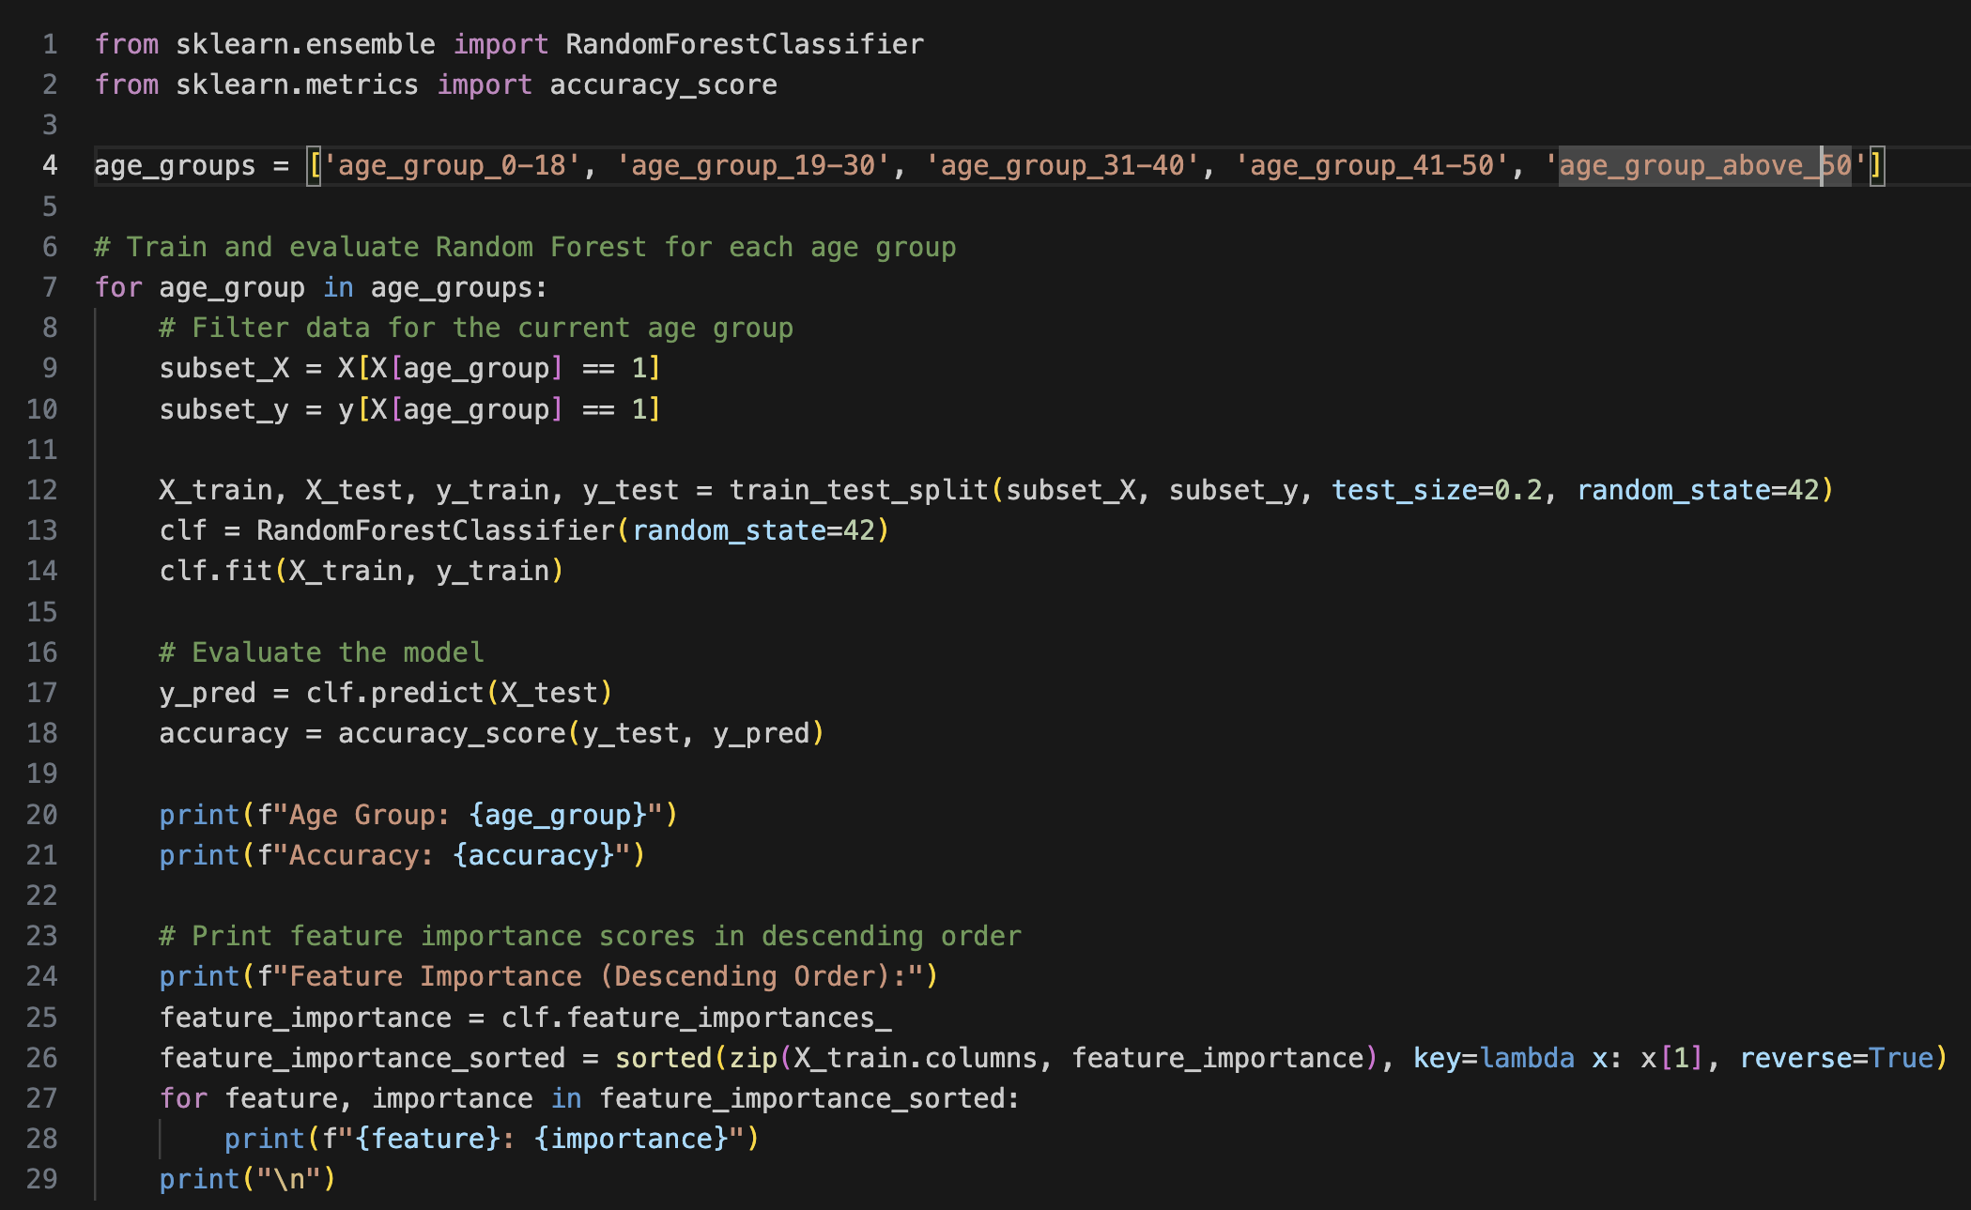
Subgroup Analysis (Random Forest)
Notes:
We try to run each age group using random forest, and to investigate the feature importance in different age group

Slide 23
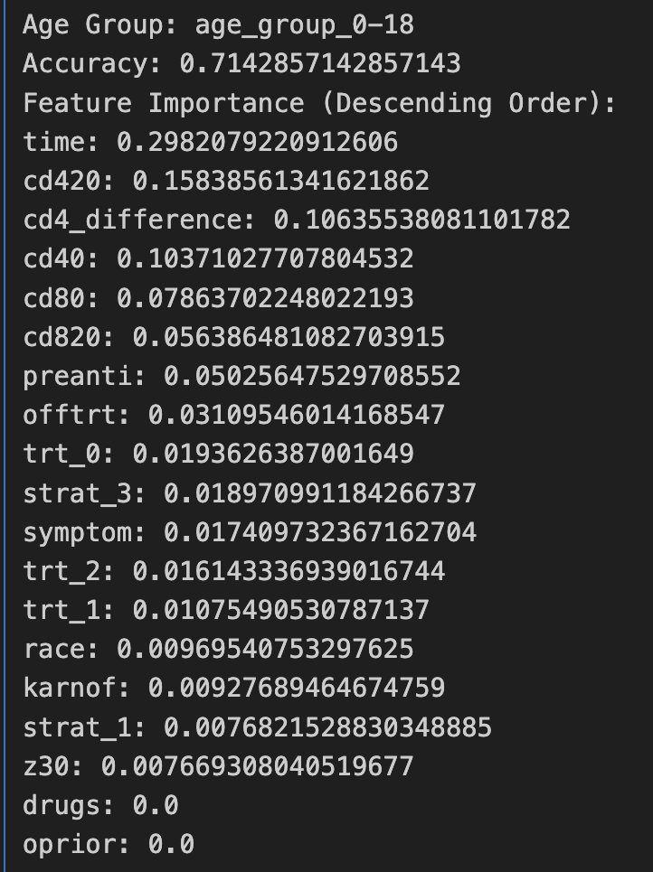
Subgroup Analysis (Result)

Slide 24
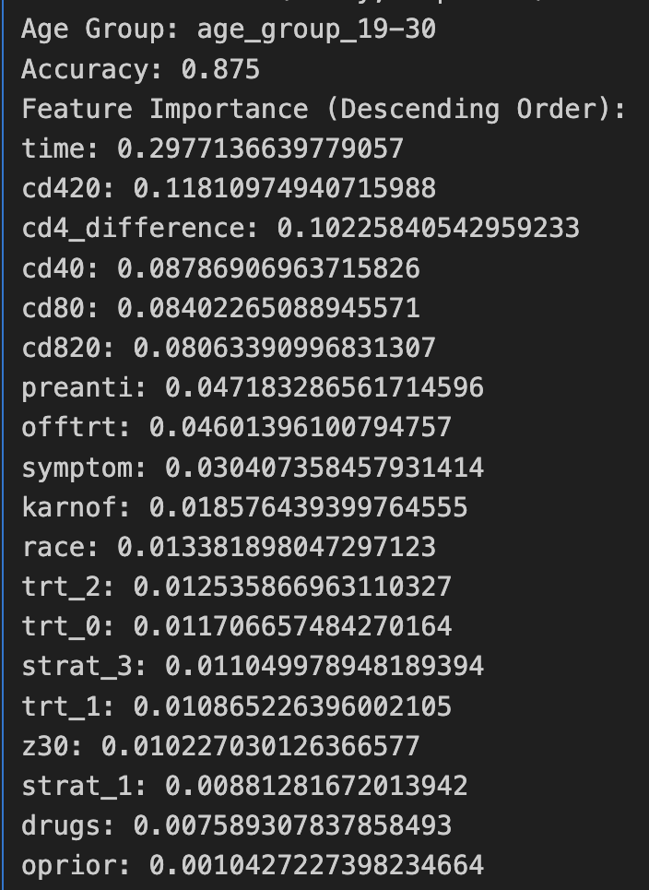
Subgroup Analysis (Result)

Slide 25
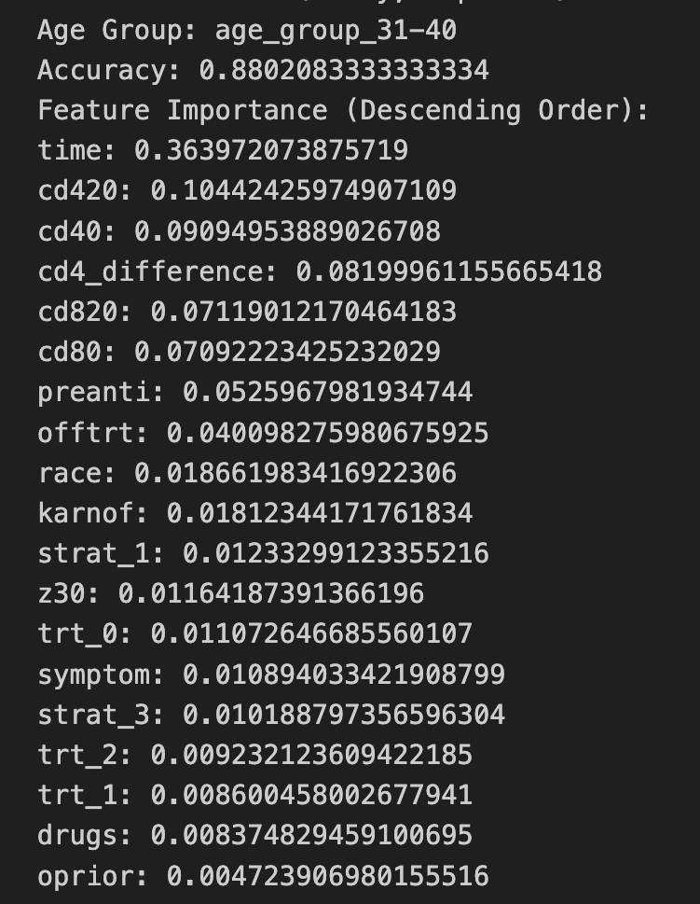
Subgroup Analysis (Result)

Slide 26
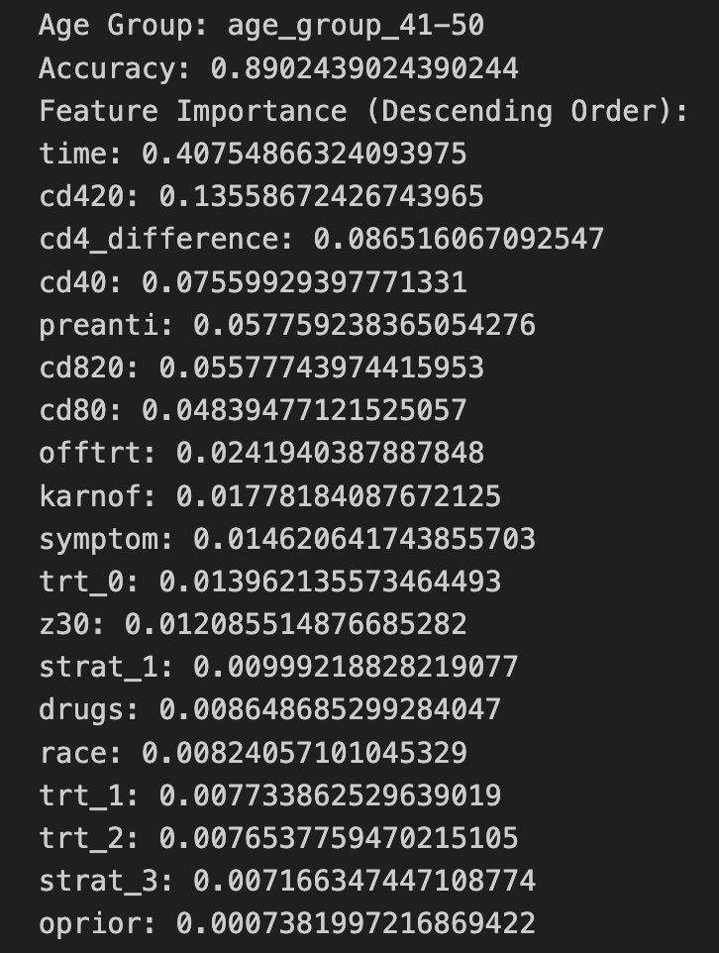
Subgroup Analysis (Result)

Slide 27
Findings
Age group | 0-18 | 19-30 | 31-40 | 41-50
Accuracy | 0.71 | 0.87 | 0.88 | 0.89
Notes:
Although we cant conclude which treatment is better, but we have another finding which is age is positively correlated with the accuracy score, when the age group is higher ,
The model tend to predict the cid more accurately, so this could be the improvement of our project, which we could try to use this finding to combine with another feature such as the number white blood of to c new insight.

Slide 28
Accuracy Score
Random Forest
Logistic Regression
86%
87%
Notes:
We will perform feature scaling for logistic regession. Although logistic regression is theoretically not sensitive to feature scaling,but it can help improve convergence speed and performance in practice.

Slide 29
Conclusion

Slide 30
Chi-squared Test
Strong Association
Time: Significant impact on the target variable.
Moderate Associations
preanti, cd420, cd40, cd80: Moderately influential features.
Moderate to Weak Associations
cd820, symptom, trt_0: Some relevance to predictions.
Weak Associations
age, strat_1, strat_3, z30: Minor impact.
Very Weak Associations
offtrt, karnof, trt_1, race, drugs, trt_2, oprior: Negligible influence.
Negligible Associations (Drop)
homo, wtkg, gender, trt_3, hemo, strat_2, zprior

Slide 31
Logistic Regression
Achieved an accuracy of approximately 86%, indicating reasonable performance in predicting the target variable.
Despite class imbalance, the model achieves relatively balanced precision and recall scores for both classes, showcasing effective handling of class imbalances.
Followers
Clients
Personal
Online

Slide 32
Random Forest Classifier
Random Forest Classifier accuracy score: 0.87
Model performs well, with approximately 87% correct predictions

Slide 33
Importance Score
Feature importance reflects the impact of each feature on predictions
Higher feature importance indicates stronger impact on predictions
However, analysis reveals relatively low importance scores for treatments in the dataset
Activities
Revenues
Channels
Relationships
It’s composed a lot of hydrogen
Neptune is beautiful planet
Earth is known as the blue planet
Ceres is in the asteroid belt

Slide 34
Summary
Despite achieving commendable accuracies (87% for Random Forest Classifier and 86% for Logistic Regression), drawing definitive conclusions regarding treatment effectiveness presents challenges.
Notable observation:
Importance scores assigned to treatments are relatively low compared to other features, notably time.
Chi-Squared Test showed moderate association of trt0.
Random forest is better suited for the dataset.

Slide 35
Conclusion
Regrettably, the analysis did not reveal significant importance attributed to the 'treatment' variable within the model. Despite its inclusion, the model's performance metrics did not highlight 'treatment' as a significant predictor. This indicates that 'treatment' may not have a substantial impact on the model's predictions
This discrepancy underscores the complexity of the dataset and suggests that further analysis and consideration are necessary to ascertain the true impact of the treatments in question.

Slide 36
Resources
AIDS clinical trials group study 175. UCI Machine Learning Repository. (n.d.). https://www.archive.ics.uci.edu/dataset/890/aids+clinical+trials+group+study+175
World Health Organization. (n.d.). HIV data and statistics. World Health Organization. https://www.who.int/teams/global-hiv-hepatitis-and-stis-programmes/hiv/strategic-information/hiv-data-and-statistics

